Slide 1
E-Commerce: Share in Retail Sales
Anitha Shanmugam
Suraj Gowthaman
Yann-Bor Wen
Feifan Wu

Slide 2






Project Background

Slide 3

Project Objectives
Retail Businesses get an idea on the proportion of e-commerce sales to total sales in future.
Firms relying highly on Brick & mortar stores can understand the impact of E-Commerce on their quarterly sales.

Slide 4

Data Overview
Year - 2000 | % - Digital Sales
March | 0.8
June | 0.9
September | 1.2
December | 1.1
By Year - 2017 | % - Digital Sales
March | 8.2
June | 8.4
September | 10.4
December | 9.2

Slide 5
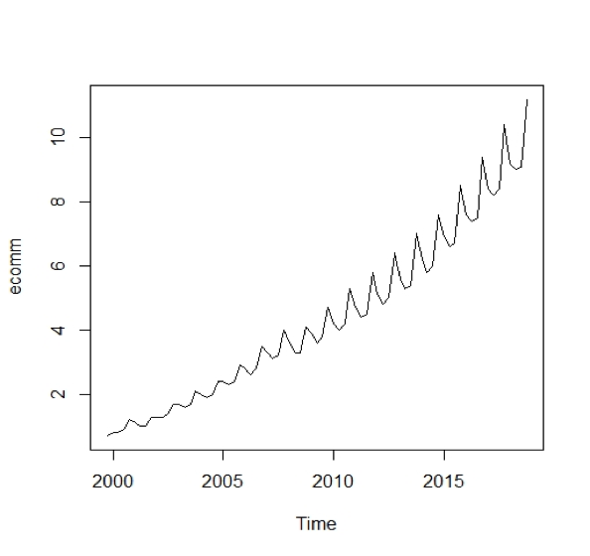
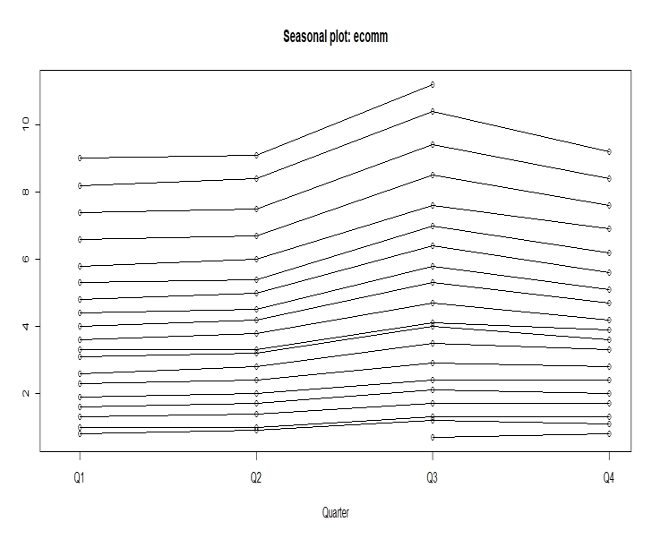
Data Overview - Contd
Linear trend
Seasonality

Slide 6
Data Analysis Process
Check for Transformation
Data Transformation
Model & Diagnostics
Residual Diagnostics and Ljung-Box Test
Unit Root Test
Difference the data

Slide 7
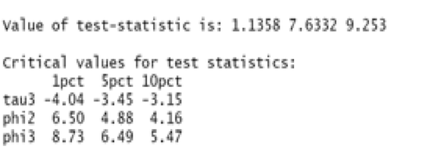
Data Transformation - Unit Root Test
H_0:a=0
H_A:a<0
T test statistic:1.1358
1%, 5%, 10% test size:-4.04, -3.45, -3.15
T test statistic>all pct critical value
Failed to Reject the Null

Slide 8
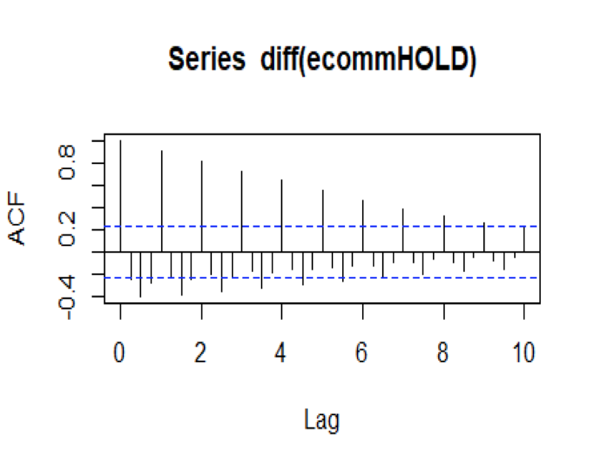
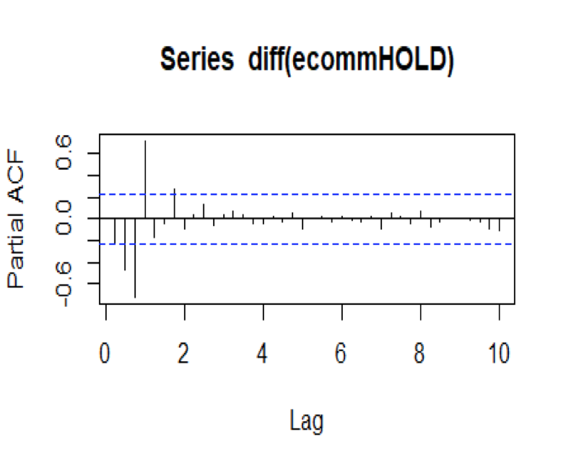
Differenced Data - Visualization

Slide 9
Results & Efficiency
 | Model | AIC | BIC
Initial Guess | (1,1,1) x (0,0,1) | 65.83 | 74.94
Trial 2 | (1,1,1) x (1,0,1) | -90.83 | -79.44
Trial 3 | (2,1,1) x (1,0,1) | -88.83 | -75.17
Trial 4 | (2,1,1) x (1,1,1) | -97.07 | -83.75
Final Model | (1,1,1) x (1,1,1) | -99.07 | -87.97

Slide 10

Ljung Box Test
We reject the null hypothesis.
Ho: autocorrelation for 40 lags = 0
Ha: -Ho
X^2 at df=40 and p-0.05 : 55.758
X-squared result 57.9 > 55.8
Low p-value

Slide 11
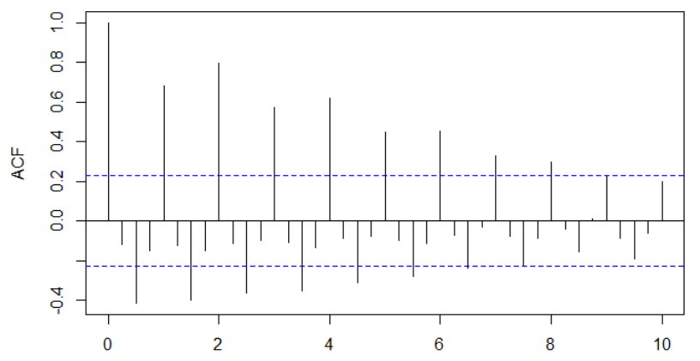
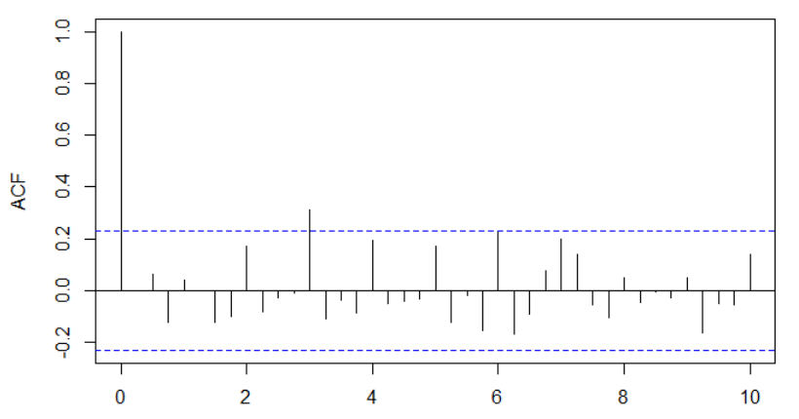
ACF for Initial vs Final Model
Final Model
Initial Model

Slide 12
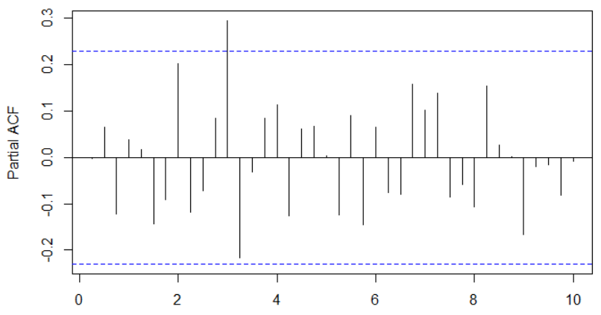
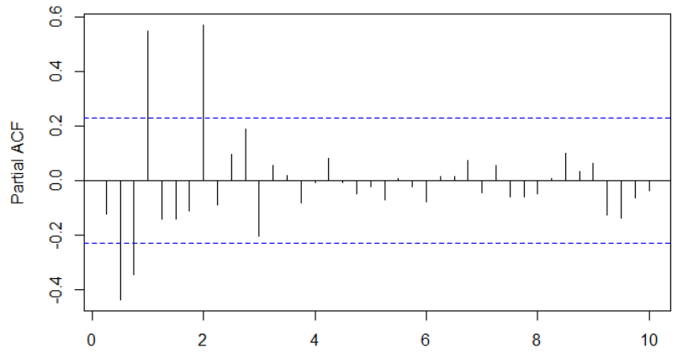
PACF for Initial vs Final Model
Initial Model
Final Model

Slide 13
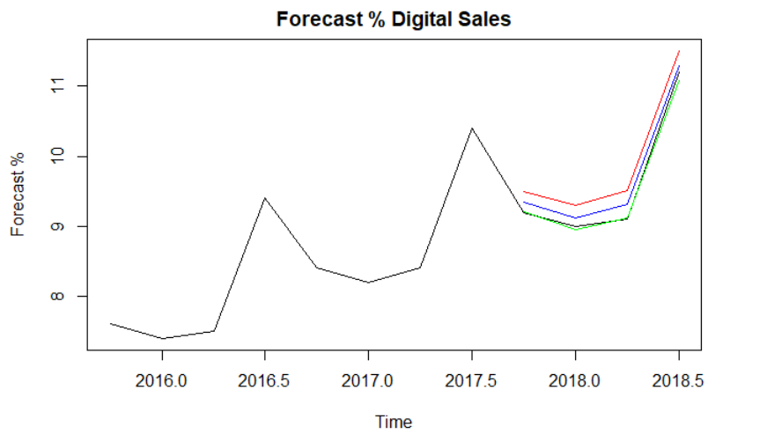
Forecast

Slide 14
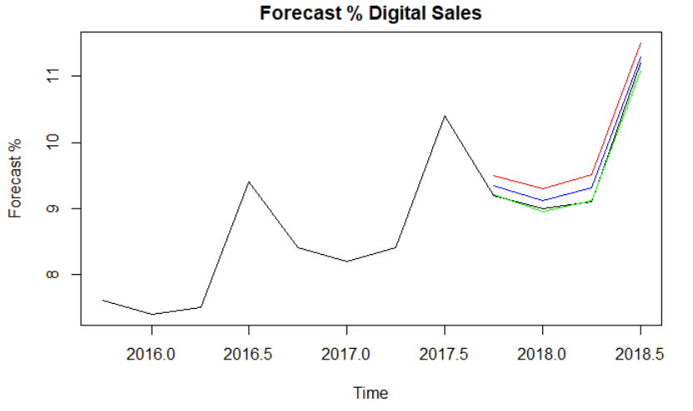
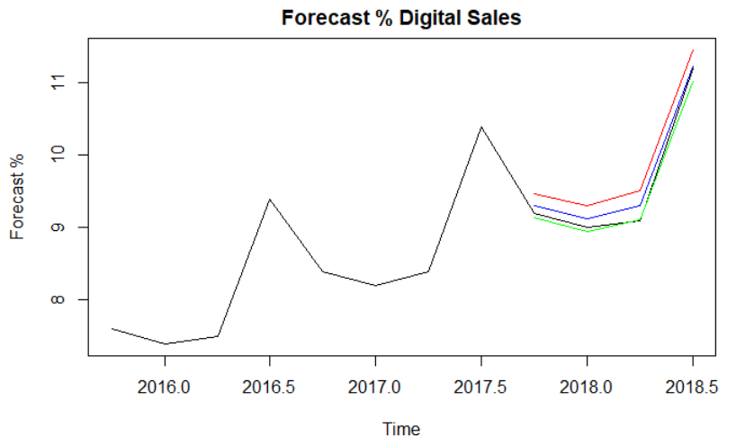
Model Comparison
SARIMA
Holt

Slide 15
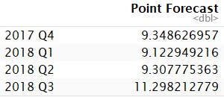
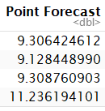

Model Comparison
SARIMA
Holt
Actual

Slide 16
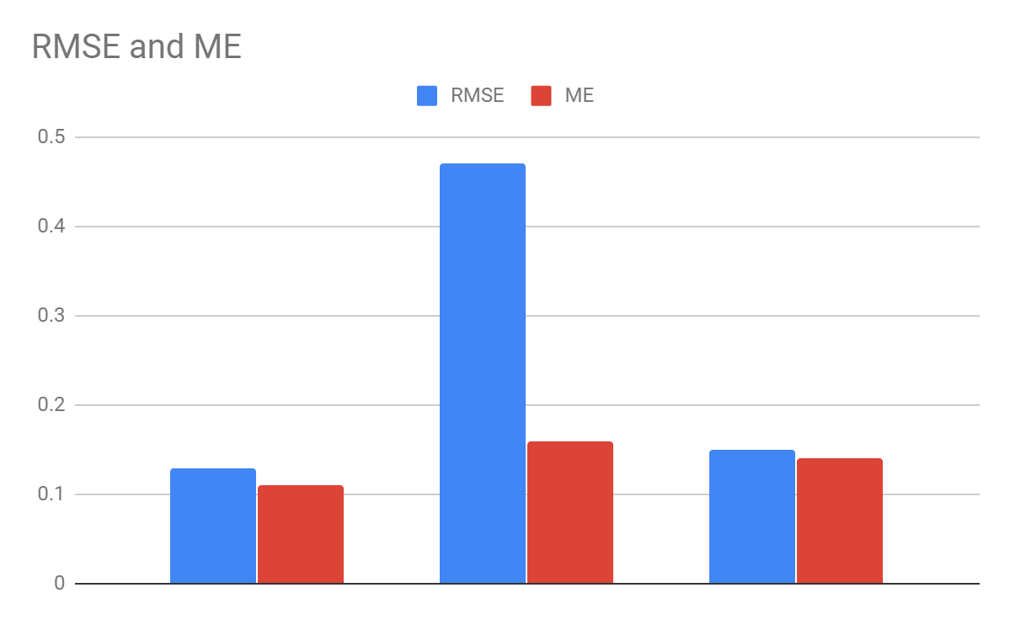

Model Comparison - Contd
Holt Initial Sarima Final Sarima

Slide 17
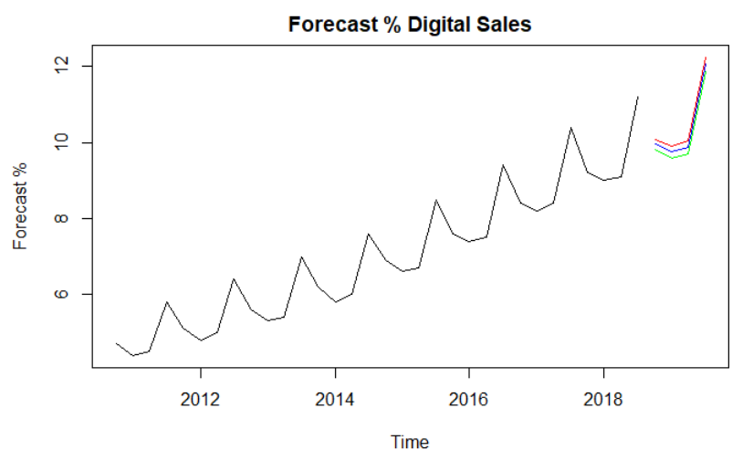
Future prediction

Slide 18
Challenges
More advanced models could possibly perform even better.
Additional data on web-traffic, customer conversion would give more insights on % sales.
This dataset is for % Digital Sales only, it is not sufficient to analyze on revenue or profitability of businesses.

Slide 19
Conclusion
It is concluded that the E-commerce has a lot of scope in increasing their overall sales percentage in the retail industry.
It is not a completely bad news for the “Brick & Mortar” stores, at this point in time, they are still way ahead in terms of number of sales they make. But more data and analysis are required in order to predict the growth of E-commerce and its potential future impact.

Slide 20
Thank You!
References:
https://fred.stlouisfed.org/series/ECOMPCTNSA
https://www.disruptiveadvertising.com/ppc/ecommerce/2018-ecommerce-statistics/

